Slide 1

Azure Databricks pySPARK Hive Demo
https://advancedsqlpuzzles.com
Scott Peters

Slide 2
OBJECTIVE
Connect Databricks to an Azure Key Vault
Connect Databricks to an Azure Data Lake
Create an ETL process to import csv files from an Azure Data Lake
Merge the data into Hive tables
Insert the data into a SQL Server database
Automate the ETL via an Azure Data Factory pipeline
For this demo, we will perform the following...

Slide 3
OBJECTIVE
The Git repository for this demo is located here:
https://Github.com/smpetersGithub/AdvancedSQLPuzzles/tree/main/Suppliers%20and%20Parts%20Hive%20Demo
Included in the repository are the following:
A PDF version of this presentation
Databricks workspace
CSV files to import
DDL scripts

Slide 4
OBJECTIVE
For this demo we will be using the Suppliers and Parts database which consists of three csv files.
Suppliers.csv
Parts.csv
Shipments.csv
It’s a popular database that has its own Wikipedia page.
The Suppliers and Parts Wikipedia article is located here:
https://en.wikipedia.org/wiki/Suppliers_and_Parts_database

Slide 5
Azure Resources
First, we will need to provision the following resources:
Azure Key Vault
Azure Data Lake
Azure Data Factory
SQL Server
SQL Server Database
Databricks Workspace

Slide 6
Azure Resources
Few reminders when provisioning the resources:
When provisioning Databricks, select the premium version as this allows for creating secret scopes.
If using an Azure free trial version, you will need to upgrade to a subscription plan to access Databricks.
The Azure Storage Account needs to be provisioned as a data lake.
A basic SQL Server database is will be sufficient for this tutorial. You will need to enable the database server to connect to other Azure resources.

Slide 7
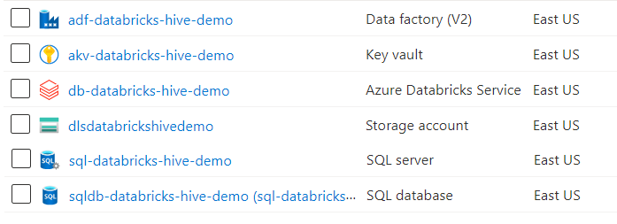
Azure Resources
For this demo I created a resource group rg-databricks-hive-demo and provisioned the following resources:
The documentation for Azure naming conventions is located here:
https://docs.microsoft.com/en-us/azure/cloud-adoption-framework/ready/azure-best-practices/resource-abbreviations
The documentation for Azure naming rules is located here:
https://docs.microsoft.com/en-us/azure/azure-resource-manager/management/resource-name-rules

Slide 8
Azure Resources
Here are the Azure resource names if you want to copy and paste.
Name | Type
db-databricks-hive-demo | Databricks
dlsdatabrickshivedemo | Azure Storage Account
akv-databricks-hive-demo | Azure Key Vault
sqldb-databricks-hive-demo | SQL Database
sql-databricks-hive-demo | SQL Server
adf-databricks-hive-demo | Azure Data Factory
Certain resources need to be globally unique, which we will cover in the next slide….

Slide 9
Naming rules and restrictions:
Azure Resources
Resource | Scope | Length | Valid Characters
Databricks | Resource Group | 3-64 | Alphanumeric, underscores, and hyphens.
Storage Account | Global | 3-24 | Lowercase letters and numbers.
Key Vault | Global | 3-24 | Alphanumeric and hyphens. Starts with letter. End with letter or digit. Can’t contain consecutive hyphens.
SQL Database | Server | 1-128 | Can't use: <>*%&:\/? or control characters. Can't end with period or space.
SQL Server | Global | 1-63 | Lowercase letters, numbers, and hyphens. Can't start or end with hyphen.
Azure Data Factory | Global | 3-63 | Alphanumeric and hyphens. Start and end with alphanumeric.
The documentation for Azure naming rules is located here:
https://docs.microsoft.com/en-us/azure/azure-resource-manager/management/resource-name-rules

Slide 10
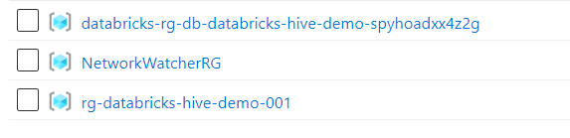
Azure Resources
When you provision the resources, additional resource groups and resources are created.
You will see an additional resource group for Databricks, and another for the Network Watcher, as shown below.

Slide 11
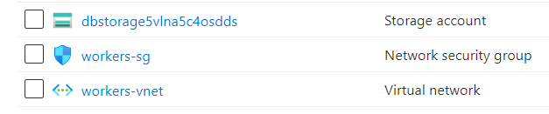
Azure Resources
The databricks-rg-db-databricks-hive-demo-spyhoadxx4z2g resource group has the following resources:
The NetworkWatcherRG resource group has the following resources:

Slide 12
Databricks
Next, we will connect our resources together.
In Databricks, we will need to understand two concepts:
Secret Scopes
Databricks Tokens
First, we will begin with secret scopes.
Secret scopes allow you to securely connect to your Azure Key Vault service, where we will store our database and storage account credentials.
There are two different ways of creating a scope:
Azure Key Vault backed
Databricks backed
The Databricks secret scope documentation is located here:
https://docs.microsoft.com/en-us/azure/databricks/security/secrets/secret-scopes

Slide 13
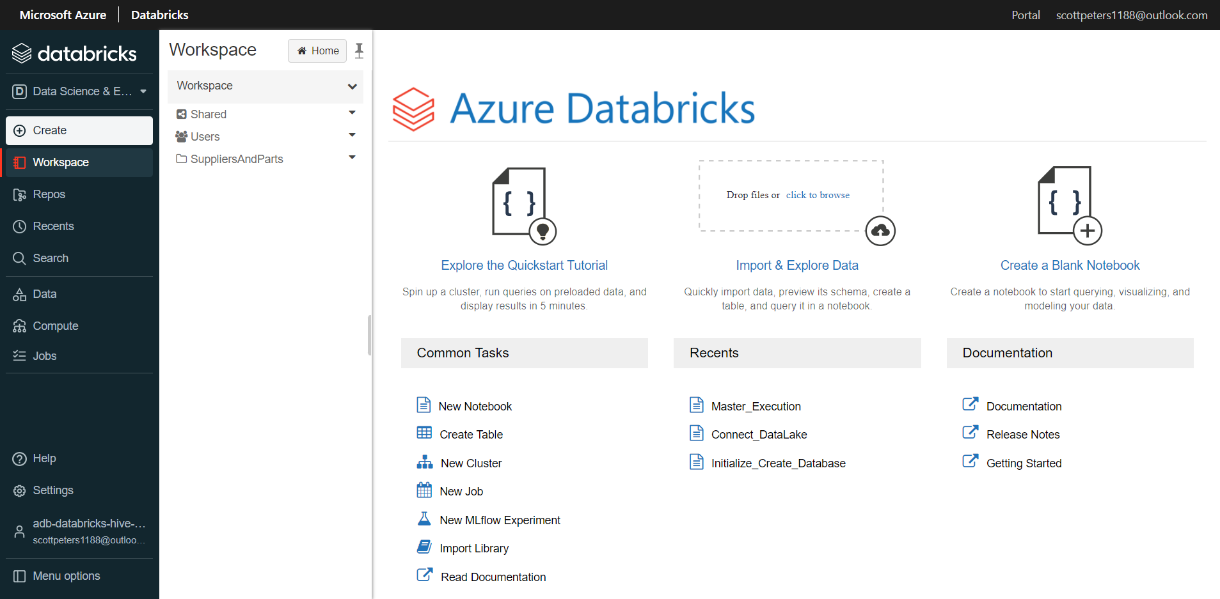
Databricks
Open the Databricks workspace.

Slide 14
Databricks
Next, in the Databricks workspace, access the Create Secret Scope window.
To access the secret scope window in Databricks, attach the string “#secrets/createScope” after your Databricks instance.
A Databricks instance will have the following URL:
https://<databricks-instance>#secrets/createScope
This URL is case sensitive; scope in createScope must be uppercase.
The documentation for Databricks secret scopes is located here:
https://docs.microsoft.com/en-us/azure/databricks/security/secrets/secret-scopes

Slide 15
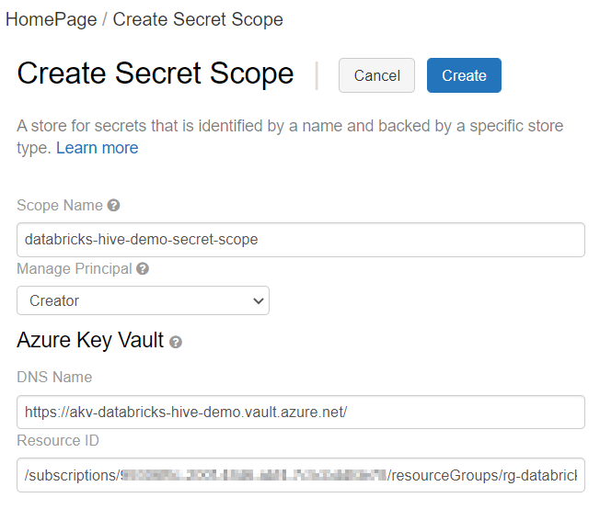
Databricks Secret scope
The Create Secret Scope window will look like the following.
We will cover the DNS Name and Resource ID in next slides.

Slide 16
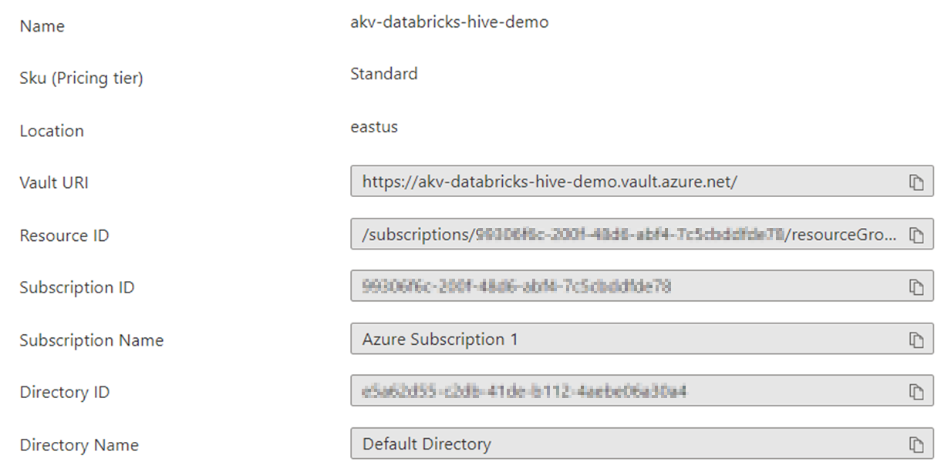
Databricks Secret scope
Azure Key Vault Properties Page
The DNS Name (Vault URI) and the Resource ID are in your Azure Key Vault properties page.
Copy these values from your Azure Key Vault properties page and insert the values into your Create Secret Scope window.

Slide 17
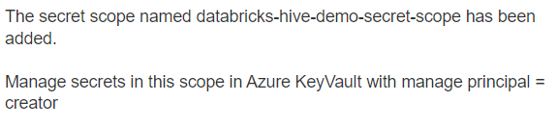
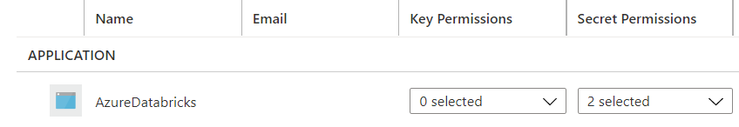
Databricks Secret scope
Once completed, the following confirmation will appear.
And you will see the following access policy added to the key vault.
The documentation for the Azure Key Vault access policies is located here:
https://docs.microsoft.com/en-us/azure/key-vault/general/assign-access-policy?tabs=azure-portal

Slide 18
Databricks Token
Next, we will create a Databricks token.
This token will allow the Azure Data Factory to access the Databricks notebook.
Tokens replace passwords in an authentication flow and should be protected like passwords.
We will use this token when we setup a linked service in our Azure Data Factory.
The documentation for Databricks tokens is located here:
https://docs.databricks.com/dev-tools/api/latest/authentication.html
This token will be stored in the Azure Key Vault, which we will setup later.

Slide 19
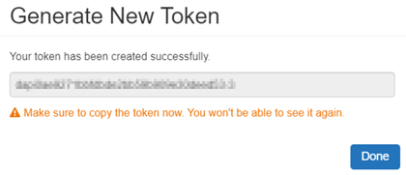
Databricks Token
Create a token in Azure Databricks by navigating to the User Settings in your Databricks workspace and selecting Generate New Token.
Save the token, as directed by the yellow warning message.
I created the token “databricks-hive-demo”, but it is the token’s value that is important, not the name. This token will be stored in the Azure Key Vault, which we will setup later.
Once created, you will see the following in your Databricks User Settings.

Slide 20
Azure Data Lake
Next, we will setup the Azure Data Lake.
Navigate to the storage account you provisioned and create two containers:
source
hive
Within the hive container create a directory called database.
Within the source container, create a directory called SuppliersAndParts.
The directory source > SuppliersAndParts is where we will store the csv files to import, and hive > Database will contain the Hive tables (which we will create later).
Upload the text files from the Git repository into the source > SuppliersAndParts container.

Slide 21
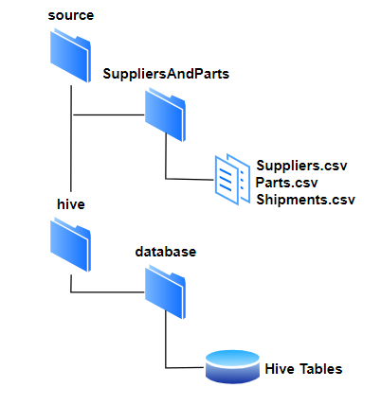
Azure Data Lake
Your file structure in the storage account will look like the following:
Copy the files Suppliers.csv, Parts.csv, and Shipments.csv files into the SuppliersAndParts folder.
The database folder will contain the Hive tables, which we will setup later in this demo.
The Git repository for this demo is located here:
https://Github.com/smpetersGithub/AdvancedSQLPuzzles/tree/main/Suppliers%20and%20Parts%20Hive%20Demo

Slide 22
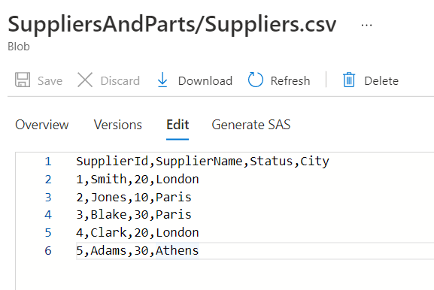
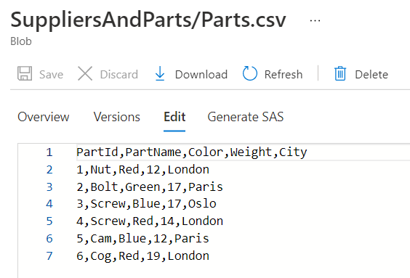
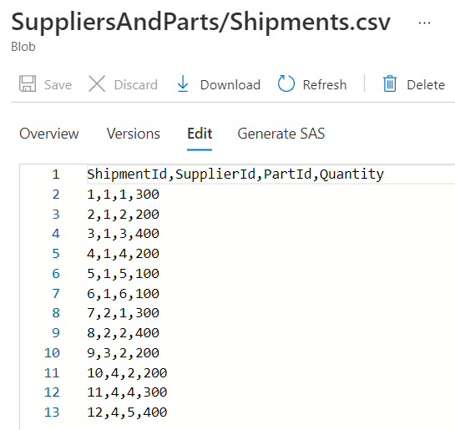
Azure Data Lake
A quick peek at the three files reveals the following contents:

Slide 23
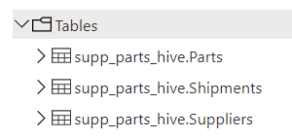
SQL SERVER DATABASE
Next, we will create the schema and tables in the SQL Server database.
The script to create the schema and tables is provided in the Git directory.
We will create a schema named supp_parts_hive and the following tables:
The Git repository for this demo is located here:
https://Github.com/smpetersGithub/AdvancedSQLPuzzles/tree/main/Suppliers%20and%20Parts%20Hive%20Demo

Slide 24
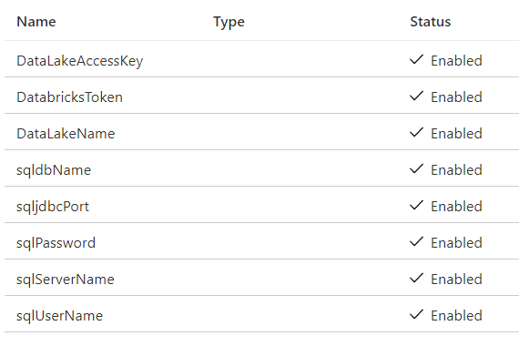
AZURE KEY VAULT
Next, we will create the secrets inside of the Azure Key Vault.
Here are the secrets you will need to setup in the Azure Key Vault.
Databricks will be able to access these values via the secret scope we created earlier.
These secrets will be used within the Databricks notebooks, except for DatabricksToken, which will be used by the Azure Data Factory linked service.

Slide 25
AZURE KEY VAULT
Secret Name | Value | Description
sqljdbcPort | 1433 | This should always be 1433
sqldbName | sqldb-databricks-hive-demo | The name of the database
sqlPassword | MyPassword | The password of the database
sqlUserName | MyUserName | The admin user of the database
sqlServerName | sql-databricks-hive-demo.database.windows.net | The database server connection string
DataLakeAccessKey | Review the next slides…. | Copied from the storage account properties
DataLakeName | dlsdatabrickshivedemo | The name of the storage account
DatabricksToken | Created in previous slides… | Used by Data Factory linked service
The two services we need Databricks to authenticate to are:
SQL Server Database
Azure Storage Account
The secret DatabricksToken will be used by the Data Factory linked service.
We will create the Azure Storage Account access key in the next slides.

Slide 26
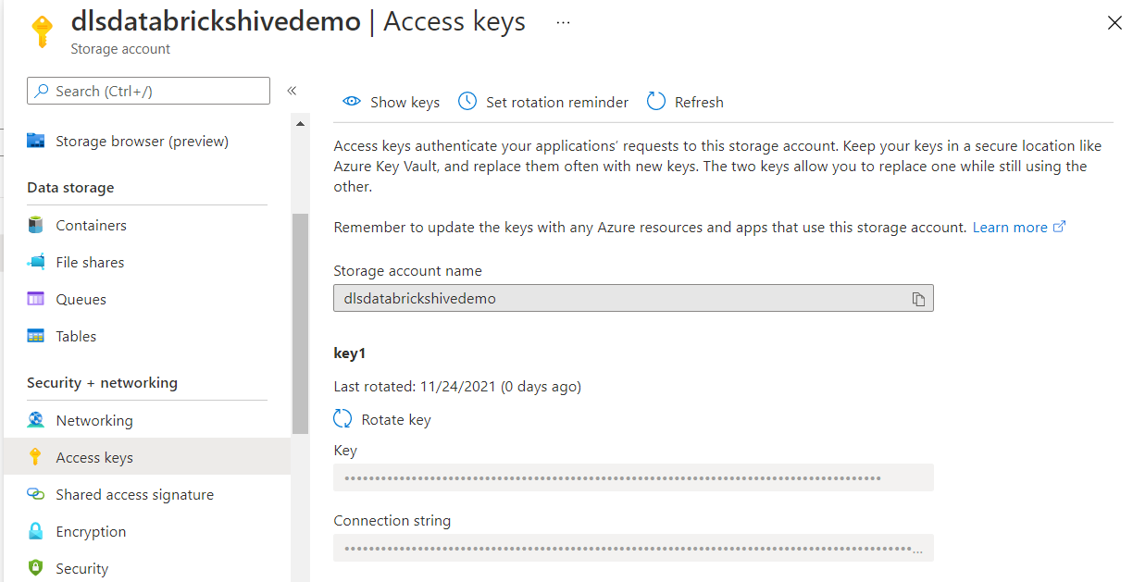
AZURE KEY VAULT
The secret DataLakeAccessKey is created by navigating to your storage account and copying the access key.
The documentation for Azure Storage Account access keys is located here:
https://docs.microsoft.com/en-us/azure/storage/common/storage-account-keys-manage?tabs=azure-portal

Slide 27
Recap
Let’s do a quick recap of everything we have accomplished so far:
We have provisioned the Azure Resources
We created a Databricks secret scope
We created a Databricks token
We setup our Azure Storage Account as a data lake with the needed directories and imported the csv files
We created the schema and tables in the SQL Server Database
We created the secret keys in the Azure Key Vault

Slide 28
Recap
Next, we will perform the following:
Import a Databricks workspace
Create a Databricks cluster
Run the database setup scripts
Review the code in the workspace
Test the Databricks workspace
Create an Azure Data Factory pipeline
Execute the Azure Data Factory pipeline

Slide 29
DATABRICKS
The following documentation gives a good overview of what we will be accomplishing for the remainder of these slides. Take a few moments to review the following documentation.
If you are unfamiliar with creating clusters, running notebooks, or navigating the workspace, I recommend working through a basic tutorial of Databricks before proceeding.
A Microsoft tutorial for incorporating Databricks into Data Factory is located here:
https://docs.microsoft.com/en-us/azure/data-factory/transform-data-using-databricks-notebook

Slide 30
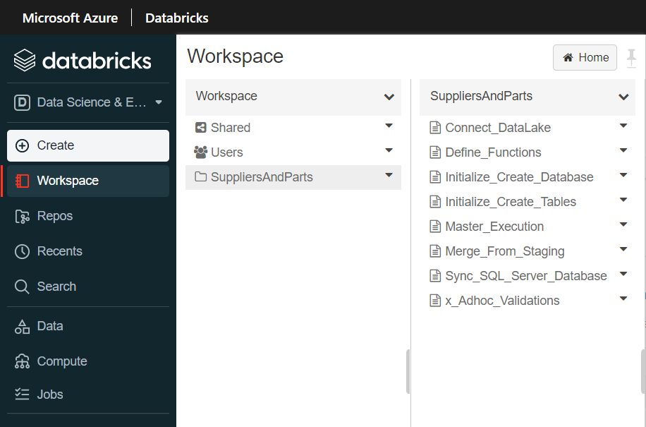
DATABRICKS
First, we will begin by importing the SuppliersAndParts.dbc workspace from the Git repository.
This workspace contains the notebooks needed to create our ETL.
Once you import the dbc file, you will see the following SuppliersAndParts folder in your workspace.
Begin by importing the workspace from the Git repository.

Slide 31
DATABRICKS
Included Notebooks
Connect_DataLake
Create_Database
Create_Tables
Insert_Hive_Staging_Functions
Insert_SQL_Server_Database
Master_Execution
Merge_Hive_Production
Validation
The workbook consists of the following notebooks:

Slide 32
DATABRICKS
Notebook | Description
Create_Database | Initial script to create the Hive database.
Create_Tables | Initial script to create the Hive tables.
Connect_DataLake | Reads variables from the Azure Key Vault and connects to the Azure Data Lake.
Insert_Hive_Staging_Functions | Recreates the Hive staging tables and then inserts the data from the csv file into the staging table.
Merge_Hive_Production | Creates the functions needed to import the csv files into the staging tables.
Insert_SQL_Server_Database | Truncates and then inserts the data from the Hive production tables into the SQL Server tables.
Master_Execution | The master notebook which calls all other notebooks.
Validation | General script used for auditing.
Here is a brief description of each notebook sorted by their purpose.
We will cover each of these notebooks in more detail.

Slide 33
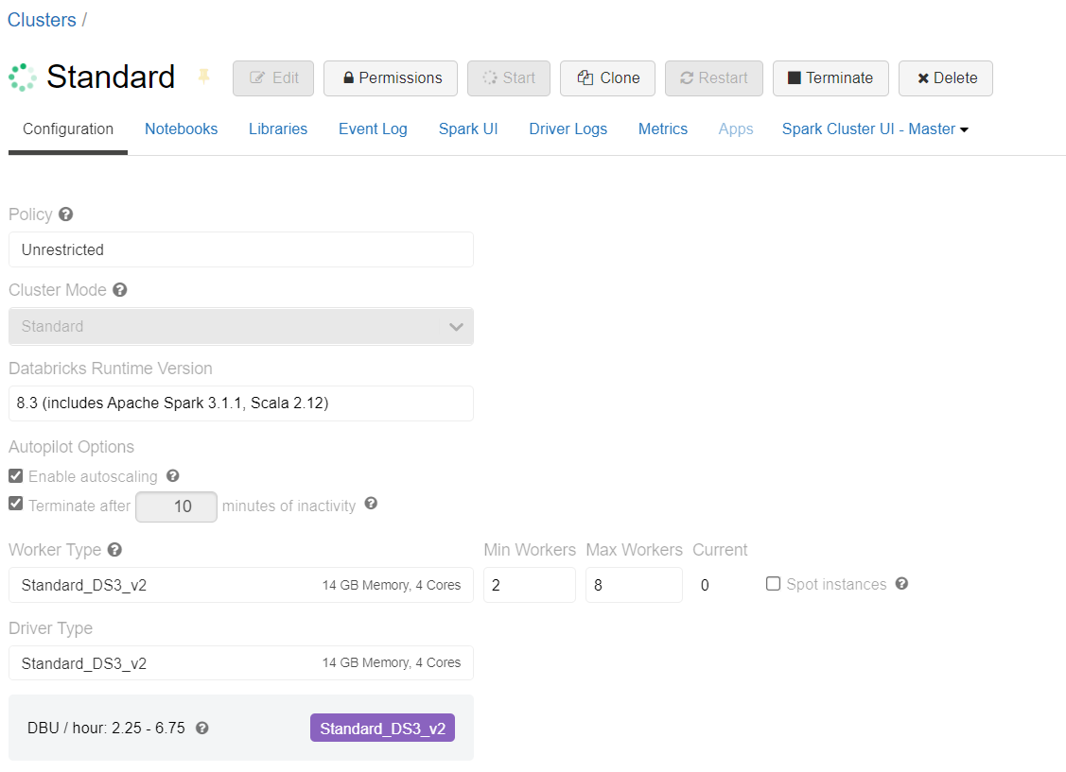
DATABRICKS
Before we move on, we need to create a Databricks cluster to run our notebooks.
The documentation for configuring Databricks clusters is located here:
https://docs.microsoft.com/en-us/azure/databricks/clusters/configure
Remember to put a termination inactivity time on the cluster!
A simple standard cluster will suffice. Feel free to experiment with different cluster sizes.

Slide 34
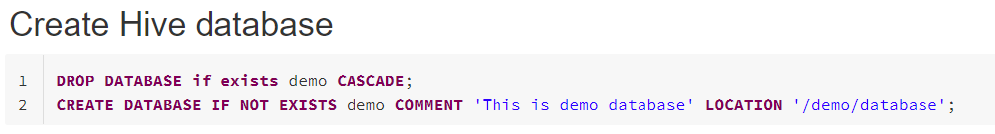
DATABRICKS
Run the following notebook first:
Create_Database
The following SQL statement creates a Hive database named demo.
First, run the notebooks that create the Hive database and tables.

Slide 35
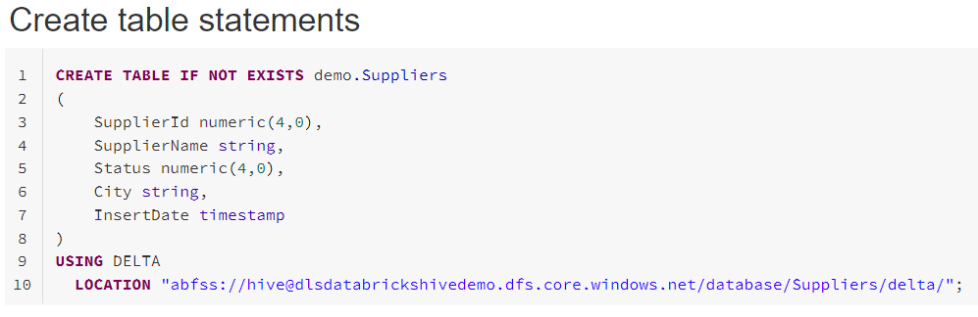
DATABRICKS
Run the following notebook next:
Create_Tables
This will create the three production tables for 1) Suppliers, 2) Parts and 3) Shipments.
You will need to change the location only if you named the Azure Storage Account directory differently than this demo.
Second, create the tables for the Suppliers, Parts and Shipments data.

Slide 36
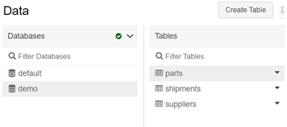
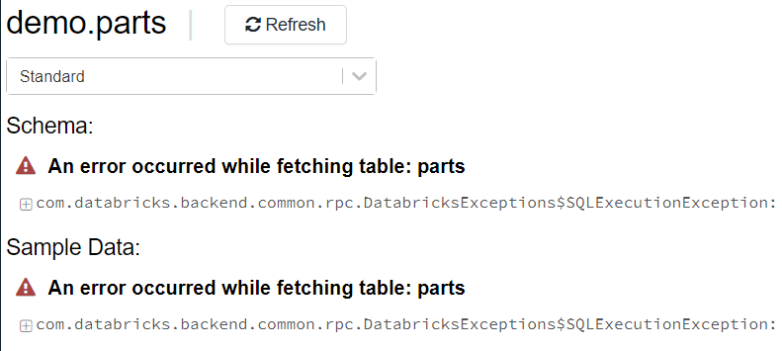
DATABRICKS
After creating the tables, you will see the production tables in the Data pane of the workspace. The staging tables will appear here after we run the pipeline for the first time.
Second, create the tables for the Suppliers, Parts and Shipments data.
You will get the following error when you select a table.
This is normal.

Slide 37
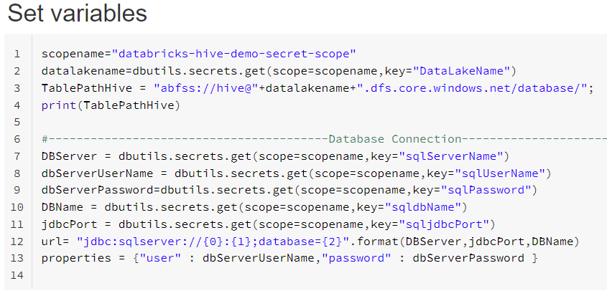
DATABRICKS
Run the following notebook to test the connection to the Azure Key Vault and the Azure Storage Account services.
Connect_DataLake
The following code connects to the Azure Key Vault.
If the Azure Key Vault secret names are different than this demo, you will need to modify these values. Note the only variable hardcoded is the secret scope that we created earlier.
Next, we will test the connection to the Azure Key Vault and the Azure Storage Account.

Slide 38
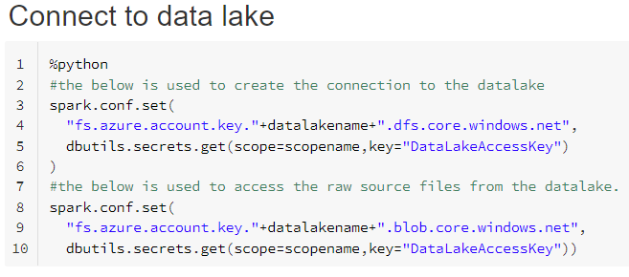
DATABRICKS
Connect_DataLake
The following code creates the connection to the data lake.
It connects once with the dfs syntax, and then again with the blob syntax.
Next, we will test the connection to the Azure Key Vault and the Azure Storage Account.
The documentation for Spark configuration settings is located here:
https://docs.microsoft.com/en-us/azure/databricks/kb/data/get-and-set-spark-config

Slide 39
DATABRICKS
Master_Execution
The Master_Execution notebook will run once for each of the three csv files:
Suppliers.csv
Parts.csv
Shipments.csv
This notebook calls the following notebooks in order:
Insert_Hive_Staging_Functions
Merge_Hive_Production
Insert_SQL_Server_Database
Next, let’s test if we can run the master notebook.

Slide 40
DATABRICKS
Master_Execution
This notebook performs the following steps:
Step 1
It first reads the functions from the Insert_Hive_Staging_Functions, which also reads the Connect_DataLake notebook.
Step 2
It then determines the variables FileName and the ProcessName.
Step 3
Next, it runs the function ProcessHiveStagingData, which is located in the Insert_Hive_Staging_Functions notebook.
Step 4
It then runs the Merge_Hive_Production notebook, and then the Insert_SQL_Server_Database.
Next, let’s test if we can run the master notebook.

Slide 41
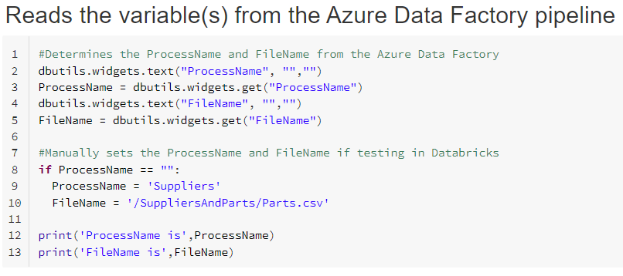
DATABRICKS
DBUTILS.WIDGETS
The dbutils.widgets code reads the variable ProcessName and FileName from the Azure Data Factory.
To test the code in Databricks, manually set the value of ProcessName and FileName where applicable.
Next, let’s test if we can run the master notebook.

Slide 42
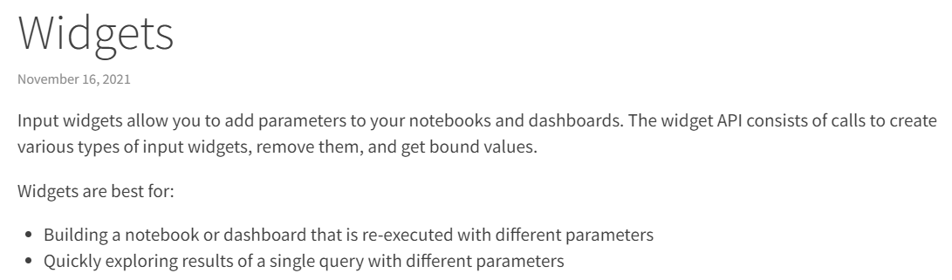
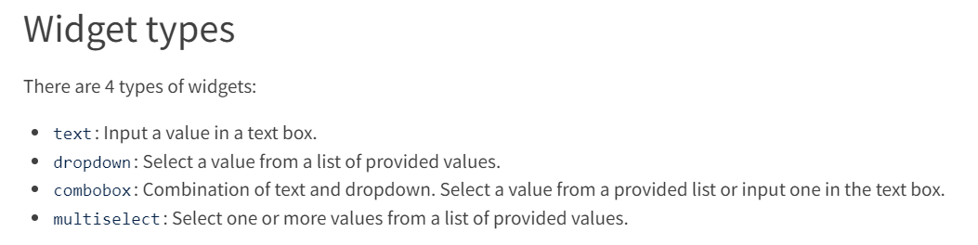
DATABRICKS
DBUTILS.WIDGETS
The documentation for Databricks widgets is located here:
https://docs.databricks.com/notebooks/widgets.html
Next, let’s test if we can run the master notebook.

Slide 43
DATABRICKS
You most probably encountered a few errors in running the master notebook.
In the next slides we will look at some of the specifics in the notebooks to help troubleshoot and understand the logic.
We will not cover all the different features of this code, but enough to be sufficient to troubleshoot, create test runs, and understand the overall process steps.
We will first start with the notebook, Insert_Hive_Staging_Functions and its various functions, before reviewing the other notebooks in this workspace.
Now we will look at some of the specifics in the notebooks.

Slide 44
DATABRICKS
Insert_Hive_Staging_Functions
This notebook defines the following functions needed to import and verify the text file and then insert the text file into the staging table.
The function ProcessHiveStagingData calls all other functions.
Order | Function Name | Description
Master | ProcessHiveStagingData | Reads the csv file and executes InsertDataToHiveFunction
1 | GetSchema | Defines the schema for the file
2 | GenerateIncomingDataHeader | Creates a data frame of the file header
3 | VerifyHeader | Validates incoming file header to schema definition
4 | InsertDataToHive | Inserts the data into the Hive tables
We will cover each of these functions in the next few slides.

Slide 45
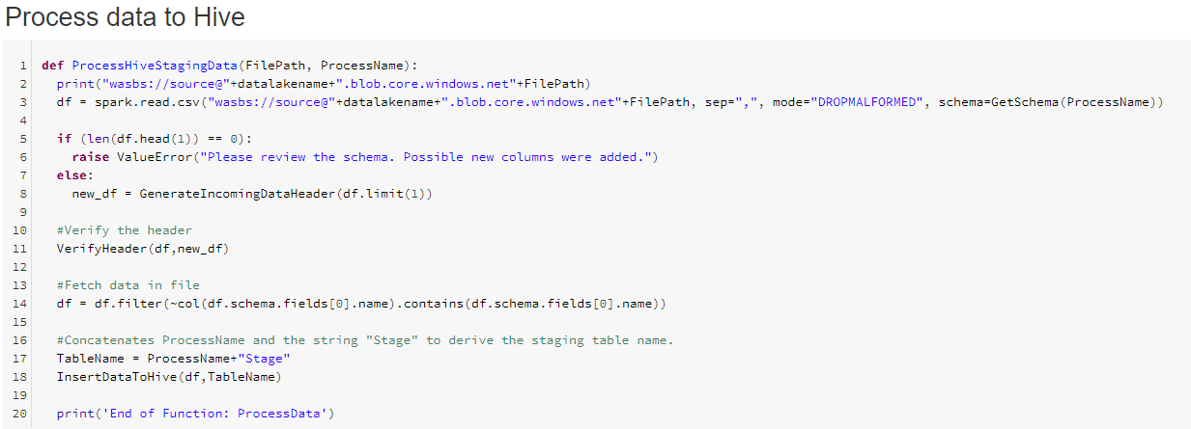
DATABRICKS
Insert_Hive_Staging_Functions
The ProcessHiveStagingData is the master function that calls the other four functions.
I have highlighted the function calls below.
Get Schema
Generate Incoming Header
Verify Header
Insert Data To Hive

Slide 46
DATABRICKS
Insert_Hive_Staging_Functions
The variable TableName is the concatenation of the variable ProcessName and the string “Stage”. Also, the field separator is set when we create the data frame.
The column separator is set here
TableName is set here

Slide 47
DATABRICKS
Insert_Hive_Staging_Functions
A Dataframe named df is also created in this function.
The csv file is imported here and a Dataframe is created via the spark.read.csv call

Slide 48
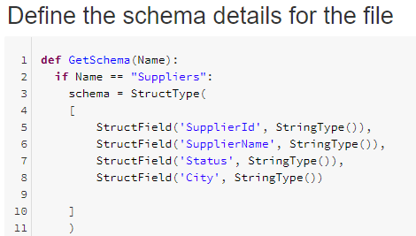
DATABRICKS
Insert_Hive_Staging_Functions
The GetSchema function in the first function called from the master function ProcessHiveStagingData.
The variable Name is passed to the function.
This defines the blueprint, known as a schema, that defines the name and data type of each column. We use StringType to define each column.
The documentation for Spark StructType class is located here:
https://spark.apache.org/docs/latest/api/python/reference/api/pyspark.sql.types.StructType.html

Slide 49
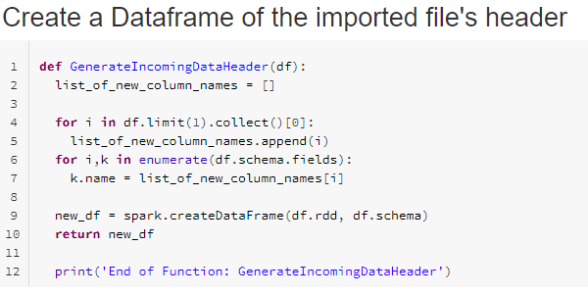
DATABRICKS
Insert_Hive_Staging_Functions
The GenerateIncomingDataHeader function creates the Dataframe new_df of the file’s header.
We need to validate the file’s header is the same as our defined schema (which we defined in GetSchema).
Which we will perform the validation in the next function, VerifyHeader.

Slide 50
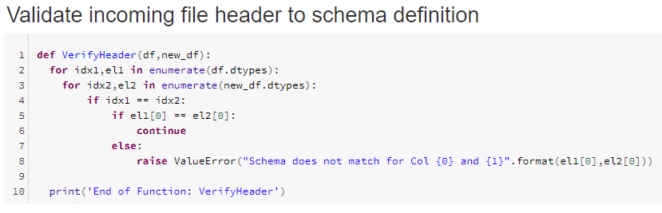
DATABRICKS
Insert_Hive_Staging_Functions
The GenerateIncomingDataHeader function creates the Dataframe new_df of the file’s header.
We need to validate the file’s header is the same as our defined schema (which we defined in GetSchema).
Which we will perform the validation in the next function, VerifyHeader.

Slide 51
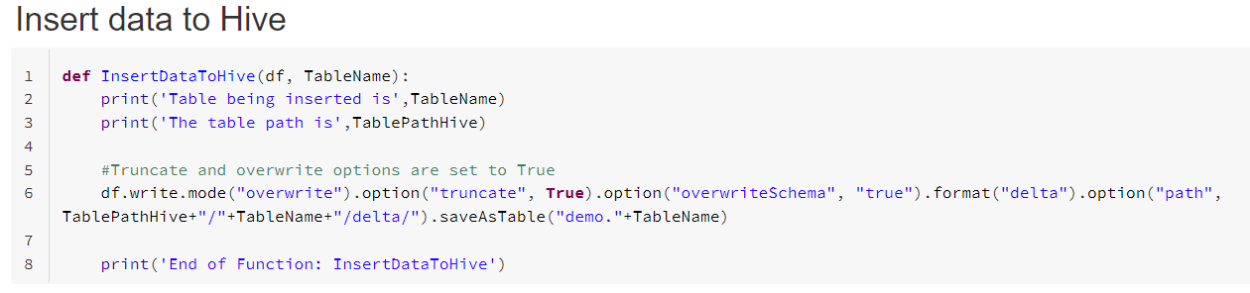
DATABRICKS
Insert_Hive_Staging_Functions
The insert into the staging table has the options of overwrite, truncate, and overwriteSchema.
On each execution the staging table is recreated and then inserted into.

Slide 52
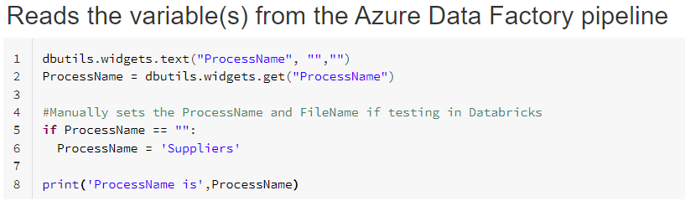
DATABRICKS
Merge_Hive_Production
This notebook merges the data from the staging to the production tables.
This notebook also uses the dbutils.widgets, which we have discussed in previous slides.
To run this notebook in Databricks for the Suppliers.csv file, manually set the variable ProcessName to Suppliers.

Slide 53
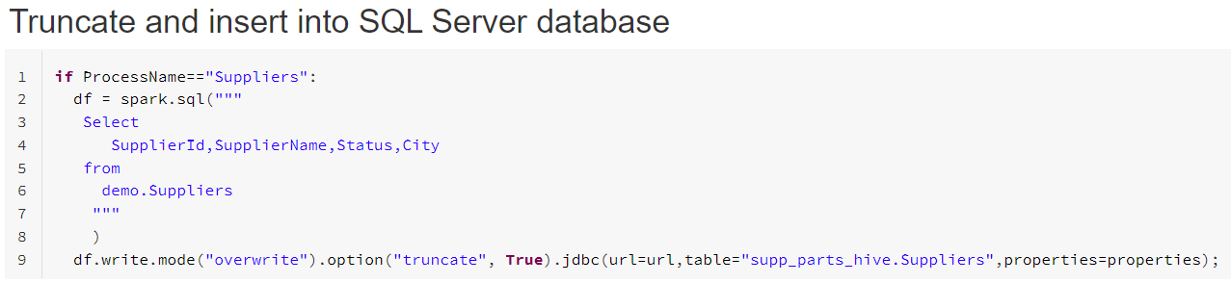
DATABRICKS
Insert_SQL_Server_Database
The insert into to the SQL Server database has the same overwrite and truncate options as the inserts into the Hive staging tables.
If you receive connection errors to the database, check that the SQL Server has the option set to connect to other Azure services.

Slide 54
DATABRICKS
Insert_SQL_Server_Database
This notebook also uses the dbutils.widgets.

Slide 55
DATABRICKS
Validations
This notebook is for creating and saving any ad-hoc statements.
After you have ran an ETL, I recommend using this notebook to explore the data.
Remember you may have only tested on your Suppliers data. The Parts and Shipments tables may be blank if you have not tested these processes.
Also available in this notebook is how to view the history of the tables.

Slide 56
Data factory
We will need to create two Azure Linked Services.
One to link to our 1) Azure Key Vault, and the second to link to the 2) Databricks Workspace.
The Databricks Linked Service will utilize the Azure Key Vault Linked Service and access the Database token we setup earlier in the demo.
We will cover these steps in the next few slides.
Next, we will setup the Azure Data Factory.

Slide 57
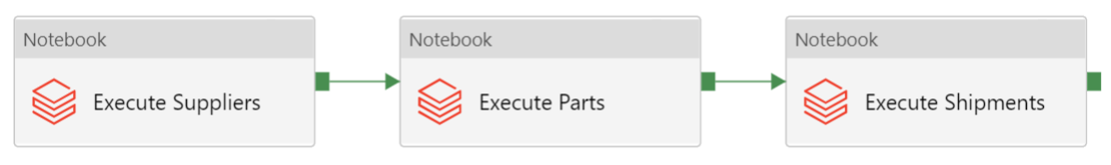
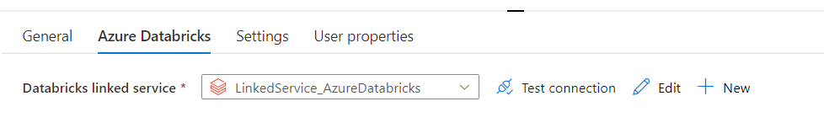
DATA FACTORY
Before we create the linked services, create a pipeline and add three Databricks notebooks activities. Chain them together to avoid getting “unexpected failure while waiting for the cluster” errors.
Each of these activities will utilize the Databricks linked service we will create in the next slides.

Slide 58
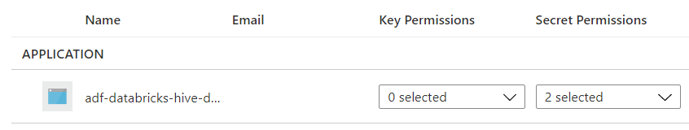
DATA FACTORY
First, the Data Factory will need access to the Azure Key Vault. Navigate to your Azure Key Vault and add an access policy that allows the Data Factory secret permissions.
The Azure Key Vault you provisioned will now have an access policy for your Databricks and the Data Factory.

Slide 59
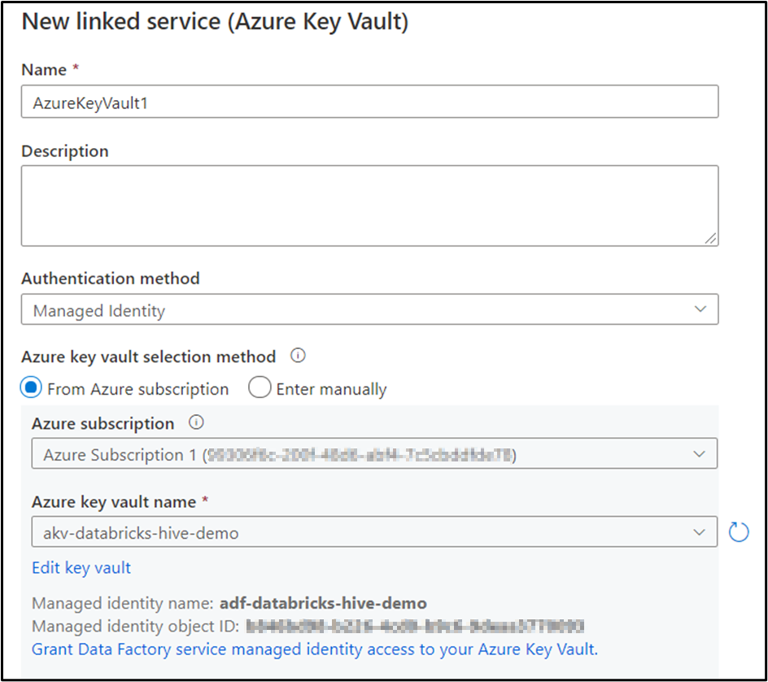
DATA FACTORY
AKV Linked Service
To link to the Azure Key Vault, create the AKV linked service using your Azure subscription.
You can also enter the AKV manually by providing the URL of the linked service, which is located in the properties page of the AKV.

Slide 60
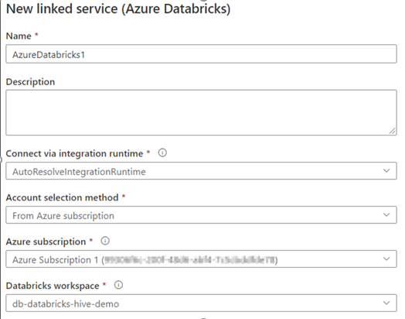
DATA FACTORY
Databricks Linked Service
To link to the Databricks workspace, fill in the following dropdowns with your subscription and workspace information.
You can also enter the information in manually by selecting Enter Manually from the dropdown box.

Slide 61
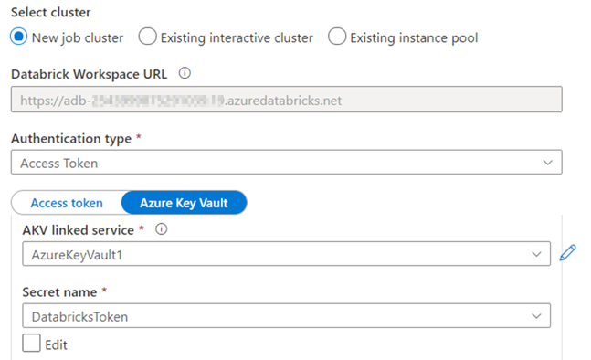
DATA FACTORY
Databricks Linked Service
Next, select Access Token as the authentication type.
Link to the AKV by using the linked service we created in a prior slide.
Then select the secret name you used to store the Databricks token.

Slide 62
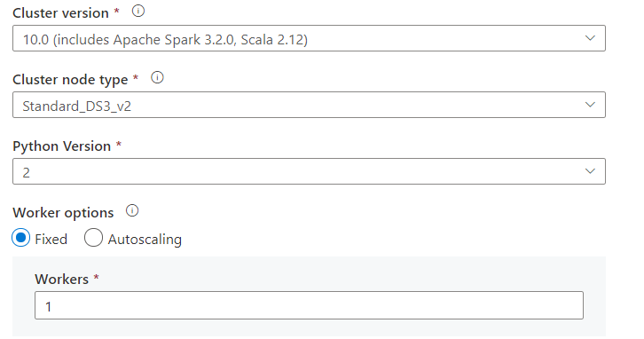
DATA FACTORY
Databricks Linked Service
Finish the linked service by filling in the rest of the fields.
Here you can see the options that I chose for cluster version, node type, etc.….
Selecting a new job cluster is the best option for cost savings, but it does add a few minutes of processing time to the pipeline to allow for the cluster to start up.

Slide 63
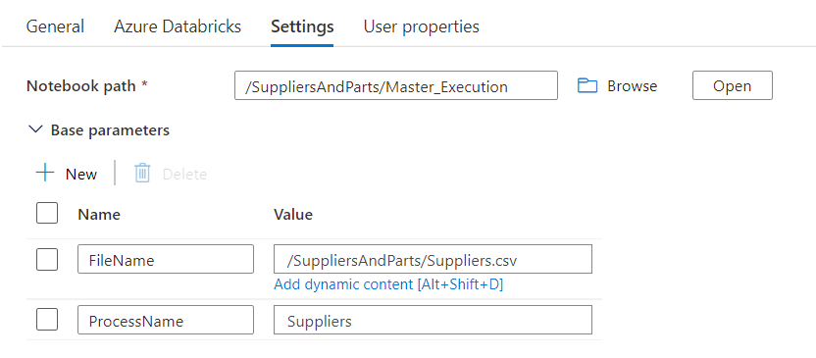
DATA FACTORY
Now let us move back to the following pipeline activities and update the Settings tab for each activity.
Select the notebook path and create two parameters 1) FileName and 2) ProcessName.
Fill in the appropriate information as shown in the screenshot.
You will need to do this for the 1) Suppliers, 2) Parts and 3) Shipments activities.

Slide 64
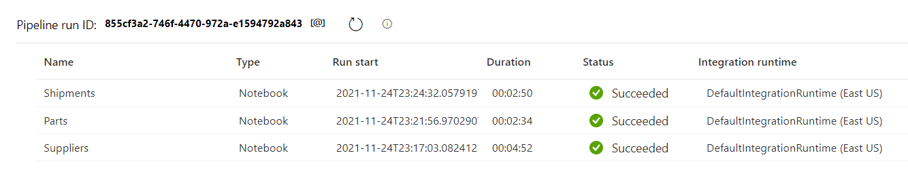
DATAFACTORY
Execute the pipeline by selecting Debug.
Ensure there is no running cluster in your Databricks workspace before executing, else you will get “unexpected failure while waiting for the cluster” error.
The total execution time for my pipeline is around 11 minutes.

Slide 65
TESTING
To test your ETL, review the data in your Hive tables with the statements in the Validations notebook. Also, review the data in the SQL Server tables as well.
Then alter the CSV files by adding new records and modifying the current records. Run the pipeline and verify the output.
To best learn the specifics of the Databricks notebooks, I recommend changing names of your AKV, storage account, secret names, etc.… determine where the notebooks break and fix accordingly.

Slide 66
CONGRATULATIONS
You now have a template for using Databricks as a transformation service!
Check out my Git repository and SQL blog for all sort of puzzles, tips and tricks.
The Git repository for this demo is located here:
https://Github.com/smpetersGithub/AdvancedSQLPuzzles/tree/main/Suppliers%20and%20Parts%20Hive%20Demo

